Slide 1

Address Binding
Usually, a program resides on a disk as a binary executable file.
Program must be brought into memory and placed within a process for it to be executed.
Input queue – collection of processes on the disk that are waiting to be brought into memory for execution.
The normal single-tasking procedure is to select one of the processes in the input queue and to load that process into memory.
As the process is executed, it accesses instructions and data from memory. Eventually, the process terminates, and its memory space is declared available.
User programs go through several steps before being executed.
Addresses may be represented in different ways during these steps.

Slide 2
Address Binding
Addresses in the source program are generally symbolic (such as the variable count).
A compiler typically binds these symbolic addresses to relocatable addresses
The linkage editor or loader in turn binds the relocatable addresses to absolute addresses (such as 74014).
Each binding is a mapping from one address space to another.

Slide 3
Address Binding
Address binding of instructions and data to memory addresses can happen at three different stages
Compile time: If memory location known a priori, absolute code can be generated; must recompile code if starting location changes. For example, if you know that a user process will reside starting at location R, then the generated compiler code will start at that location and extend up from there.
Load time: Must generate relocatable code if memory location is not known at compile time
Execution time: Binding delayed until run time if the process can be moved during its execution from one memory segment to another.
Need hardware support for address maps (e.g., base and limit registers)

Slide 4
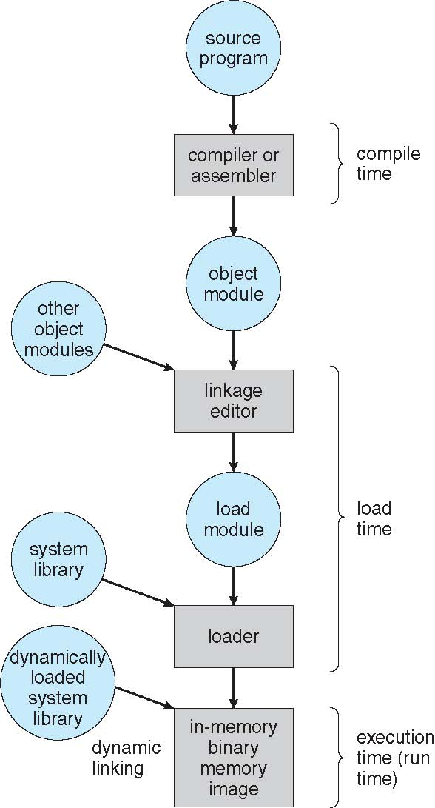
Address Binding

Slide 5
Logical vs Physical Address
An address generated by the CPU is commonly referred to as a logical address,
An address seen by the memory unit—that is, the one loaded into the memory-address register of the memory—is commonly referred to as a physical address.
The compile-time and load-time address-binding methods generate identical logical and physical addresses.
However, the execution-time address binding scheme results in differing logical and physical addresses.
In this case, we usually refer to the logical address as a virtual address
The run-time mapping from virtual to physical addresses is done by a hardware device called the memory-management unit (MMU).

Slide 6
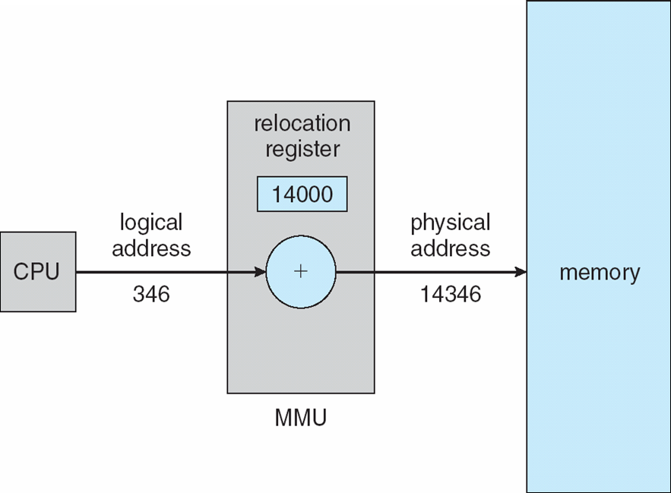
Logical vs Physical Address
The base register is now called a relocation register
The value in the relocation register is added to every address generated by a user process at the time the address is sent to memory.
The user program never sees the real physical addresses. The program can create a pointer to location 346.
Only when it is used as a memory address (in an indirect load or store, perhaps) is it relocated relative to the base
Register.
The user program deals with logical addresses. The memory-mapping hardware converts logical addresses into physical addresses.

Slide 7
Dynamic Loading
It is necessary for the entire program and all data of a process to be in physical memory for the process to execute. The size of a process has thus been limited to the size of physical memory.
To obtain better memory-space utilization, we can use dynamic loading
With dynamic loading, a routine is not loaded until it is called. All routines are kept on disk in a relocatable load format.
The main program is loaded into memory and is executed. When a routine needs to call another routine, the calling routine first checks to see whether the other routine has been loaded.
If it has not, the relocatable linking loader is called to load the desired routine into memory and to update the program’s address tables to reflect this change.
Then control is passed to the newly loaded routine.

Slide 8
Dynamic Loading
The advantage of dynamic loading is that a routine is loaded only when it is needed.
This method is particularly useful when large amounts of code are needed to handle infrequently occurring cases, such as error routines.
In this case, although the total program size may be large, the portion that is used (and hence loaded) may be much smaller.
Dynamic loading does not require special support from the operating system.
It is the responsibility of the users to design their programs to take advantage of such a method

Slide 9
Dynamic Linking and Shared Libraries
Dynamically linked libraries are system libraries that are linked to user programs when the programs are run.
Linking postponed until execution time.
This feature is usually used with system libraries, such as language subroutine libraries.
Without this facility, each program on a system must include a copy of its language library in the executable image.
This requirement wastes both disk space and main memory

Slide 10
Dynamic Linking and Shared Libraries
With dynamic linking, a stub is included in the image for each library routine reference
Small piece of code, stub, used to locate the appropriate memory-resident library routine.
When the stub is executed, it checks to see whether the needed routine is already in memory. If it is not, the program loads the routine into memory
Stub replaces itself with the address of the routine, and executes the routine.
Operating system needed to check if routine is in processes’ memory address.

Slide 11
THANK YOU

